Slide 1



Vegetable
Market Analysis
And Delhi Market Study
PROJECT TEAM MEMBERS
AMARJEET ROY
VANSHPAL SINGH
PRAVEEN

Slide 2
INTRODUCTION :
Welcome to the Vegetable Market Analysis presentation!
Our team has conducted an in-depth analysis of the vegetable market in Noida.
In this presentation, we will share our findings and insights on various aspects of the market.
By examining average monthly prices, comparing prices with nearby markets,
analyzing seasonal variations, studying income groups, and exploring the quick commerce vegetable business, we aim to provide a comprehensive understanding of the market dynamics.
Our research involved the use of the Selenium library in Python for efficient data extraction from online sources.
•The case study explores the market size and potential, competitive landscape, key challenges, key success factors, and the role of technology in improving operations and customer experience.
•The research aims to provide fresh insights into the vegetable market and the quick commerce vegetable business in Delhi.

Slide 3



OBJECTIVES:
•Collect comprehensive and reliable data from the website to support the analysis of the vegetable market.
•Conduct an analysis of the vegetable market in Noida.
•Understand price trends and variations in vegetable prices.
•Identify seasonal vegetables based on price analysis.
•Analyze the preferences of different income groups in the vegetable market.
•Compare vegetable prices in Noida with nearby markets.
•Provide actionable recommendations for stakeholders in the vegetable market to make informed decisions.

Slide 4
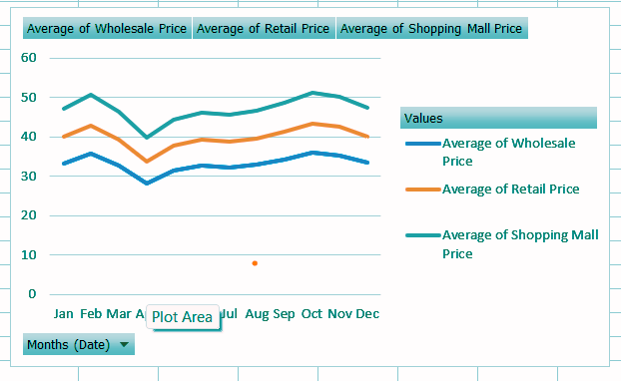



"THE AVERAGE MONTHLY PRICE OF VEGETABLES IN THE NOIDA MARKET"
OBSERAVTIONS:
Prices in Noida tend to vary throughout the year, with higher prices in October and lower prices in April.
Seasonal Trends: There is a consistent pattern of prices increasing from January to October and slightly decreasing towards the end of the year.
Price Differences: Shopping mall prices are generally higher than both wholesale and retail prices in Noida, likely due to additional costs associated with running a shopping mall.
Stability: The average prices for wholesale, retail, and shopping mall categories in Noida show relatively stable market conditions.

Slide 5

SEASONAL VEGETABLES BY OBSERVING THE FLUCTUATIONS IN PRICE ON DIFFERENT TIME PERIODS
40
ASH GOURD
The chart illustrates the price fluctuations of different seasonal vegetables over time.
30
It showcases the variations in prices during different months or seasons throughout the year.
20
The fluctuations in vegetable prices can be influenced by external factors such as weather conditions, season, location , and market demand.
10
The chart reveals correlations between price movements and vegetables season.
0
Mar
Apr
May
Jun
Jul
Aug
Sep
Oct
Nov
Dec

Slide 6
DIFFERENCES OR SIMILARITIES IN THE PRICES OF VEGETABLES IN NOIDA AND NEARBY MARKET
OBSERAVTIONS:
Agra
Delhi
Noida
100
Delhi and Agra have similar vegetable prices, indicating price stability between these markets.
Noida consistently offers lower prices for most vegetables, making it a cost-effective option.
The price difference highlights the potential for significant savings in Noida.
Factors such as proximity to agricultural regions and market competition contribute to the lower prices.
Noida's lower prices provide opportunities for affordability and improved profit margins.
75
50
25
0
Amla
Garlic
Baby Corn
Drumsticks
Green Peas
Mango Raw
Mushroom
Butter Beans
French Beans
Lemon (Lime)

Slide 7
DIFFERENCES OR SIMILARITIES IN THE PRICES OF VEGETABLES IN NOIDA VEGETABLE MARKET
Average of Wholesale Price
Average of Retail Price
Average of Shopping Mall Price
60
40
20
0
Jan
Feb
Mar
Apr
May
Jun
Jul
Aug
Sep
Oct
Nov
Dec

Slide 8



"VEGETABLE BASKET EXPENDITURE BY INCOME GROUP"
Low Income
Middle Income
CUCUMBER
ASH GOURD
Raw Banana
POTATO
ONION BIG
CORIANDER LEAVES
POTATO
ONION BIG
SPINACH
CARROT
BROAD BEANS
Brinjal (Big)
Price 113
Price 329
High Income
BABY CORN
MUSHROOM
French Beans
POTATO
Onion Green
GARLIC,GINGER
Price 530

Slide 9
"INFLATION RATE FOR EACH INCOME GROUP"
March 2022
March 2023
Findings From Charts
600
Low-income group: The basket price has increased by 21% compared to the previous period, indicating a significant impact on their expenditure.
Middle-income group: The basket price has decreased by 20%, reflecting a potential improvement in affordability for this income segment. The middle-income group also has a wider range of vegetable choices, allowing them to switch to cheaper options when prices are high.
High-income group: The basket price has increased by 10%, suggesting a relatively smaller impact on their overall expenses.
These findings highlight the varying effects of price changes on different income groups and the need for tailored strategies to address affordability concerns.
Understanding the specific challenges and preferences of each income group is crucial for designing targeted interventions and pricing policies.
400
200
0
Low Income
Middle Income
High Income

Slide 10
CHANGE IN BASKET PRICE OF DIFFERENT INCOME GROUPS OVER TIME
Low Income
Middle Income
High Income
600
400
200
0
Feb-22
Mar-22
Apr-22
May-22
Jun-22
Jul-22
Aug-22
Sep-22
Oct-22
Nov-22
Dec-22
Jan-23
Feb-23
Mar-23

Slide 11
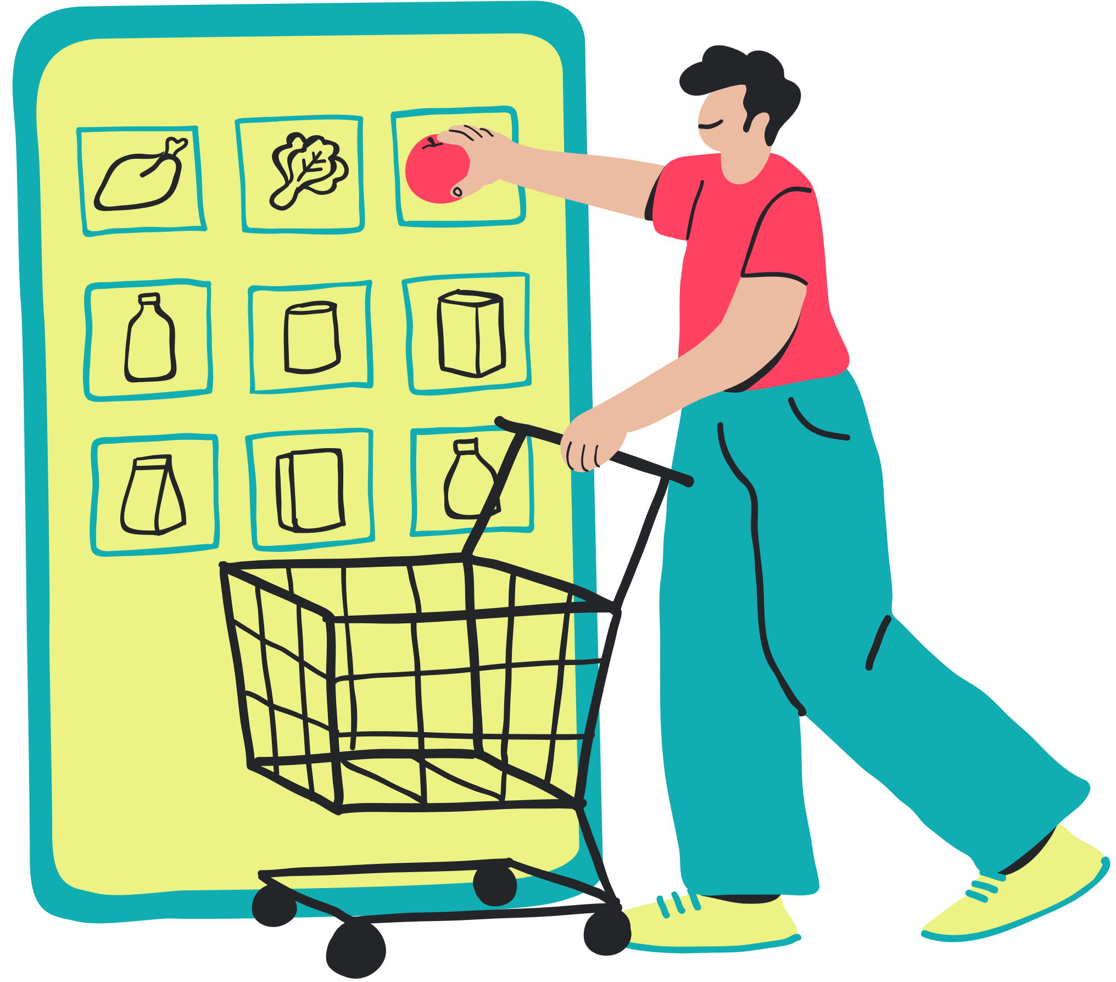
Case Study on Quick Commerce Vegetable Business in Delhi:

Slide 12

Market Size and Potential for Quick Commerce Vegetable Business in Delhi:
Large Population
Urban Lifestyle:
Delhi's population drives demand for convenient grocery shopping, attracting quick commerce vegetable businesses.
Delhi's urban lifestyle demands time-saving solutions, driving the growth of quick commerce vegetable businesses for convenient online ordering and fast delivery services.
Increasing Internet Penetration:
Delhi's increasing internet penetration allows quick commerce vegetable businesses to reach a larger customer base through online platforms.
Rising Disposable Income:
Delhi's thriving economy and higher disposable income create a lucrative market for quick commerce vegetable businesses, prioritizing quality and convenience.

Slide 13

Competitive landscape for quick commerce vegetable business in Delhi:
Identify and analyze existing players in the quick commerce vegetable market in Delhi
Competitor Analysis
Market Share Assessment
Evaluate their market share, customer base, pricing strategies, delivery options, and customer reviews.
Assess the strengths and weaknesses of competitors to identify opportunities for differentiation and competitive advantage.
Evaluation of Competitors' Strategies

Slide 14


Key challenges faced by the quick commerce vegetable business in Delhi
Maintaining Freshness and Quality
Customer Expectations
Understand the logistical challenges such as maintaining the freshness of vegetables during storage and transportation.
Address the challenge of last-mile delivery in a densely populated and traffic-prone city like Delhi.
Delivery Challenges
Price Sensitivity and Competition
Manage customer expectations regarding delivery time, quality, and product variety.
Overcome price sensitivity and competition from existing players by offering unique value and discounts

Slide 15


KEY SUCCESS FACTORS
Strong Brand Presence
Make a strong brand presence through effective marketing and advertising strategies to build customer base.
Variety of Fresh Vegetables
Provide a wide variety of fresh and high-quality vegetables, including both seasonal and non-seasonal options.
Customer Service
Offer competitive prices, attractive to attract and retain customers.
Competitive Pricing and Discounts
Prioritize exceptional customer service responses to queries or complaints and hassle-free return or exchange policies.
Innovation and Adaptation
Continuously innovate and adapt to changing market trends and customer preferences.

Slide 16


LEARNINGS/KEY TAKEAWAYS:
Data extraction can be challenging, particularly with large datasets and multiple sources, requiring careful handling and organization.
When analyzing data, it is important to consider the context and be mindful of the assumptions made during calculations to ensure accurate and meaningful insights are derived.
FUTURE SCOPE:
Consider analyzing the quantity of vegetables sold for a comprehensive market view.
Enhance analysis by exploring factors like consumer preferences, market competition, and emerging trends, using advanced data analytics techniques and machine learning algorithms for improved forecasting accuracy.

Slide 17


CONCLUSION
The vegetable market analysis project shed light on the price trends and preferences of different income groups in Noida.
It emphasized the importance of tailoring strategies to address affordability concerns and meet the diverse needs of consumers.
The findings underscored the potential for the quick commerce vegetable business in Delhi and the significance of online platforms in catering to the urban lifestyle.

Slide 18


THANK YOU
The project providers for their trust, allowing us to showcase our skills and make a meaningful impact.
Our dedicated team members for their hard work in conducting the analysis.
Our mentors and guides for their invaluable support and guidance throughout the project.
Everyone present today for their time and attention.
The Selenium library in Python for facilitating data extraction and analysis.

